Slide 1

ShopWise: Unlocking Purchase Behavior
This presentation explores predicting online shoppers' purchase intentions. E-commerce platforms face the challenge of understanding customer purchasing behavior. By analyzing user data and applying machine learning models, we aim to uncover insights that can improve marketing strategies and boost sales.
IE 7275: Data Mining in Engineering

Slide 2

Problem Setting & Definition
Every day, millions of potential customers silently vanish from e-commerce sites, taking billions in unrealized revenue with them, all because retailers can't decode the critical signals hidden in their browsing behavior. While mountains of user data pile up—from click patterns to session durations—most companies remain blind to the powerful purchase intent indicators buried within, costing them conversions and allowing competitors to steal their most valuable prospects. The difference between e-commerce leaders and strugglers isn't better products or lower prices, but rather their ability to transform chaotic behavior data into precise purchase predictions that power personalized marketing, inventory decisions, and customer experiences. Those who crack this code first will dominate their markets for years to come, while those who fail will watch helplessly as their conversion rates—and profits—steadily decline.
What hidden patterns in user browsing behavior can reveal a customer's true purchase intent before they even reach the checkout page?
How can we transform mountains of chaotic e-commerce data into precise predictive models that accurately forecast which customers are most likely to complete a purchase?
Which advanced classification algorithms and data preprocessing techniques deliver the highest accuracy in predicting purchase intent, enabling retailers to focus resources on customers ready to buy?

Slide 3
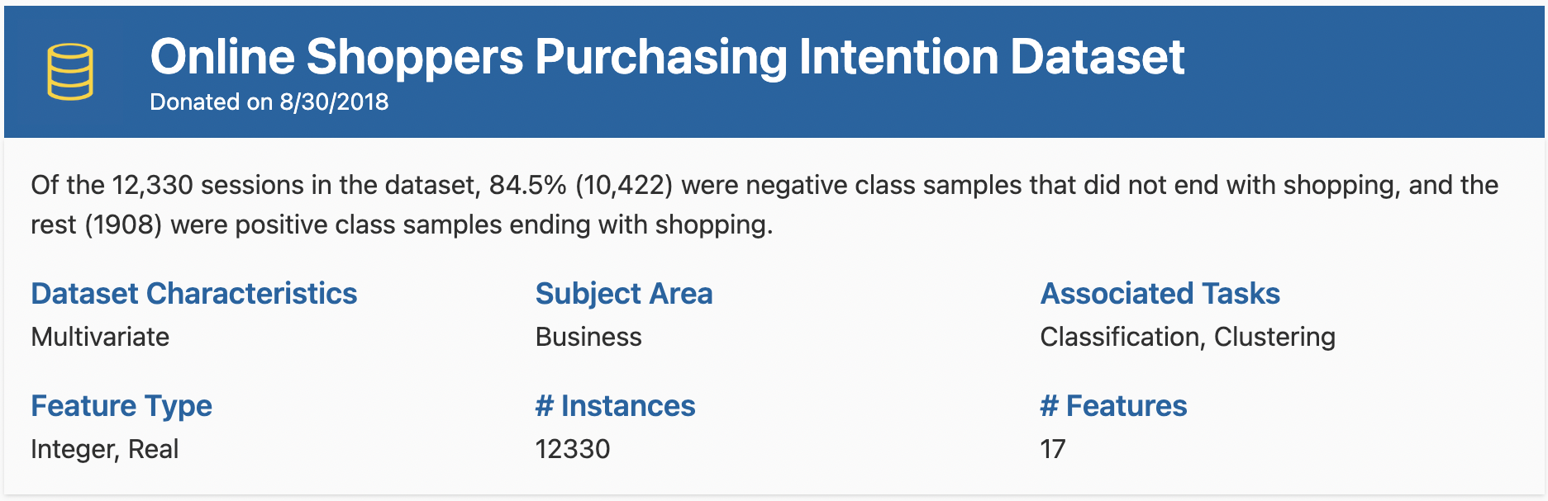
Data Source and Description
12,330 REAL SHOPPING SESSIONS REVEAL THE TRUTH
We've excavated the Online Shoppers Purchasing Intention Dataset from the UCI Machine Learning Repository, a treasure trove of authentic e-commerce behavior capturing the exact moment when browsers become buyers.
18 PREDICTORS tracking every digital footprint
10 NUMERIC METRICS quantifying customer engagement
8 CATEGORICAL VARIABLES classifying visitor behaviors
1 CRITICAL TARGET VARIABLE: "Revenue"
What Will We Do ?
Find out what influences shoppers to make purchases.
Discover at least 3 key factors that impact buying decisions.
Build models that predict which visitors will buy something.
Test 5 different prediction methods and pick the best one.
Balance our data to better identify potential buyers.
Simplify complex data while keeping the important information.
How We'll Measure Success?
Our prediction accuracy must reach 90% or higher.
We'll improve our ability to identify potential buyers by 15%.
We'll maintain 85% of important data while reducing complexity.
We'll rank the top 5 factors that influence purchasing decisions.
We'll compare 5 different prediction methods using clear metrics.
We'll deliver a complete report with all findings and recommendations.

Slide 4
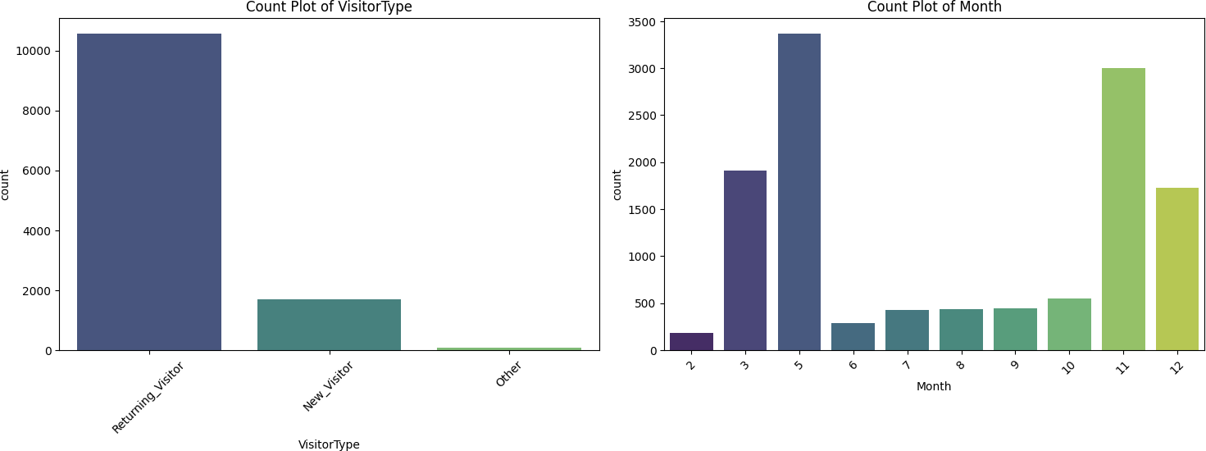
Data Pre-processing and Exploration – Categorical Variables
Visitor Behavior Patterns
Returning Visitors Dominate the Platform (85% of traffic)
Returning visitors make up approximately 10,000 sessions compared to only 1,700 new visitors
This indicates strong customer loyalty but potential challenges in customer acquisition
Seasonal Shopping Patterns
Two Major Traffic Peaks Drive Annual Revenue
May (month 5) shows highest traffic (~3,400 visits)
November (month 11) shows second-highest traffic (~3,000 visits)
These months likely correspond to spring shopping and pre-holiday purchasing
Special Days Impact
Special shopping days significantly influence purchasing behavior
Data indicates lower bounce rates and higher page values during special days
The dramatic difference between normal days and special days creates an opportunity for targeted strategies

Slide 5
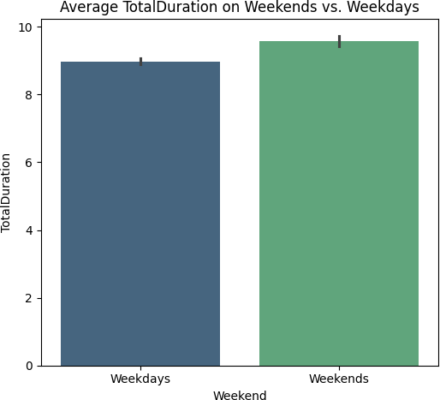
Data Pre-processing and Exploration – Numerical Variables
Weekend Shopping Behavior
Users Spend More Time on Weekends: Average session duration is approximately 9.6 minutes on weekends versus 9.0 minutes on weekdays
10% Longer Engagement: This significant increase in browsing time represents a major opportunity for conversion
Session Duration
Total Duration combines all interaction times (Administrative, Informational, and Product-Related)
Longer Sessions = Higher Intent: Users who spend more time on the site show stronger purchase signals
Revenue Generation
Monthly Revenue Fluctuations: Conversion rates vary significantly throughout the year
Correlation with Traffic: Higher traffic months generally show higher conversion rates, but with important exceptions

Slide 6
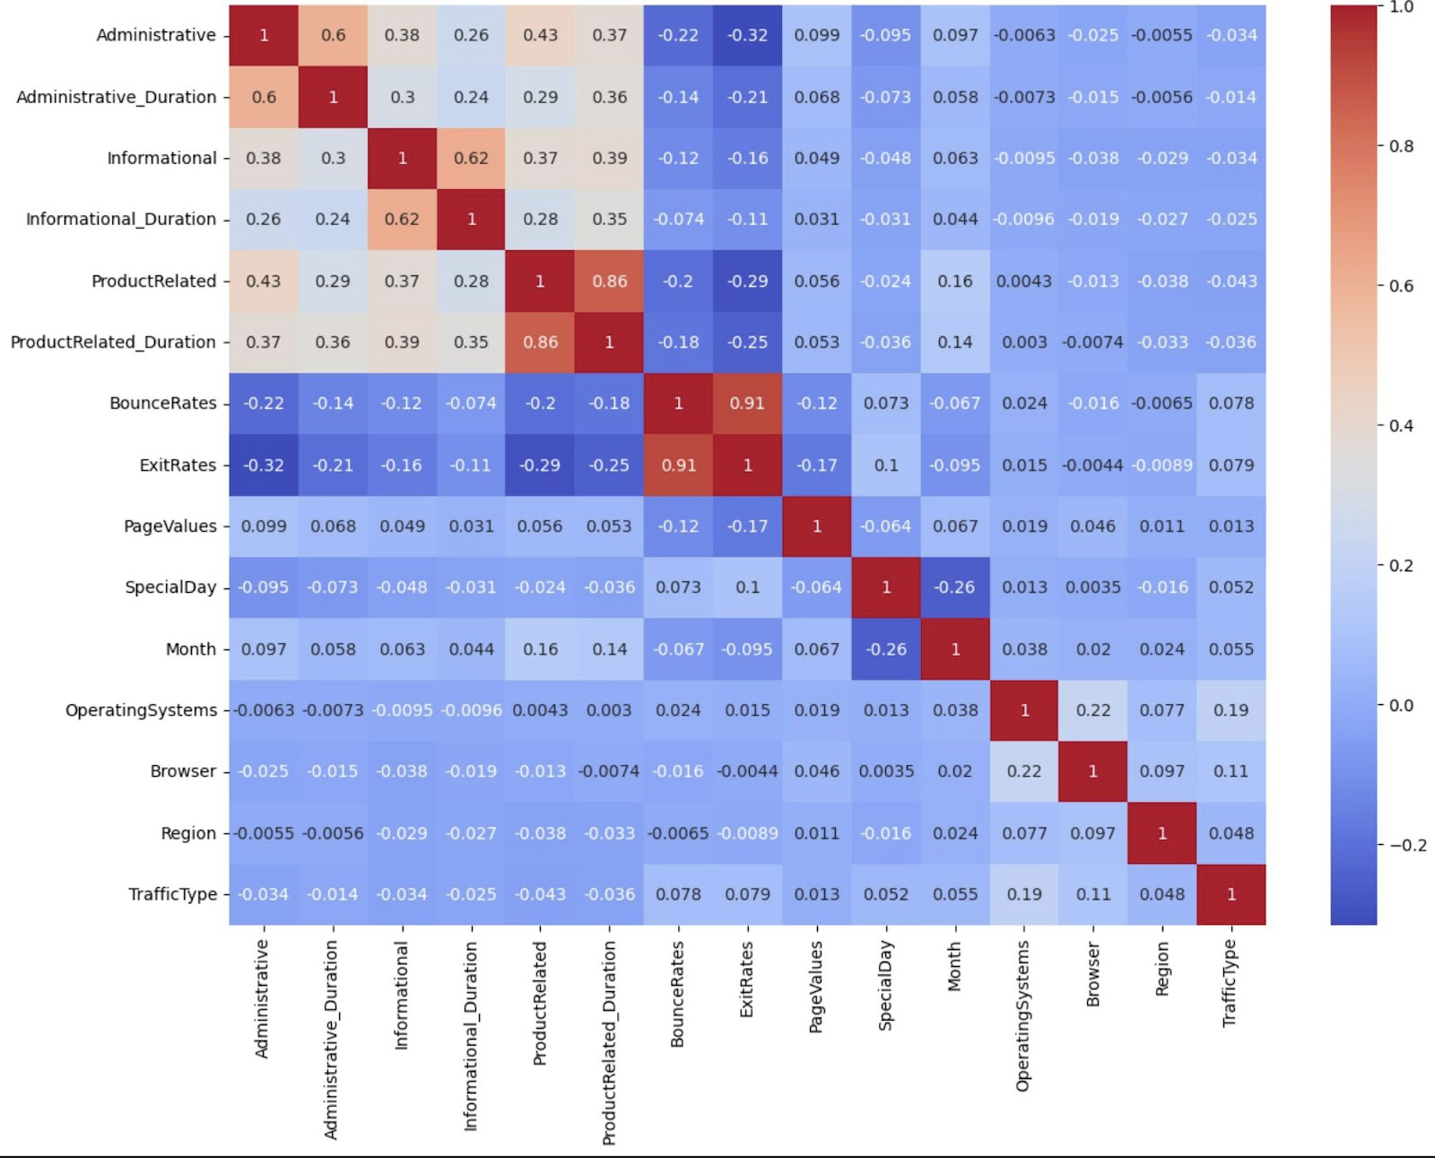
Correlation Analysis
Strong Behavioral Connections
Product Engagement Cluster: Product page views and duration are highly correlated (0.86)
Users who view more product pages spend proportionally more time on them
This creates a powerful engagement metric to track purchase probability
Exit Behavior Patterns: Bounce rates and exit rates show extremely high correlation (0.91)
These metrics effectively measure the same user disengagement pattern
Revealing Independence
Seasonal Factors Stand Alone: Month and SpecialDay show minimal correlation with browsing metrics
These time-based factors influence purchases independently of browsing behavior
Critical insight: Multiple independent factors are driving purchases
Multicollinearity Warning Signs
Highly correlated features can cause problems in predictive models
May need to select one representative metric from each correlated cluster
Consider feature engineering to combine correlated metrics

Slide 7
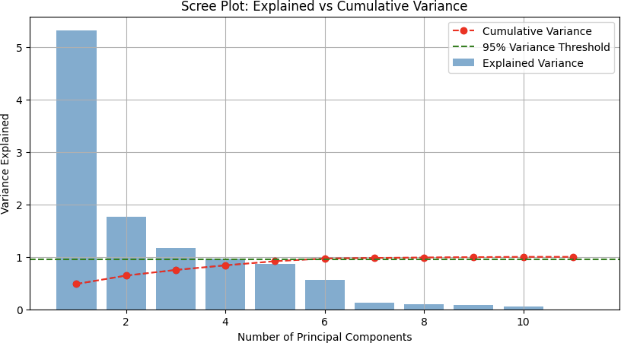
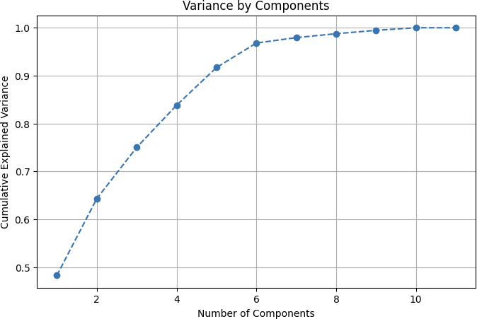
PCA Results
Dominant First Component
The first principal component stands out dramatically in the scree plot with ~5× more explained variance than any other component
This indicates one strong underlying pattern dominates the data
Clear Dimensionality Threshold
Both visualizations show we need only 5-6 components to capture 95% of the data's variance
The 95% threshold line in the scree plot intersects with the cumulative variance line at this point
This gives us confidence in reducing from all original variables to just 6 components
Diminishing Returns
Components 7-11 add minimal value, each contributing less than 0.2 units of variance
The cumulative variance curve flattens significantly after component 6
Using more than 6 components would add complexity without meaningful information gain
Natural "Elbow Point”
Both visualizations show a clear "elbow" at components 5-6
This natural breaking point helps confirm our optimal dimensionality choice

Slide 8
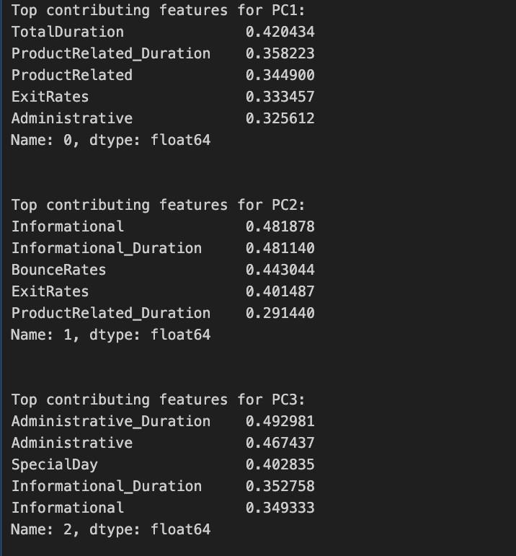
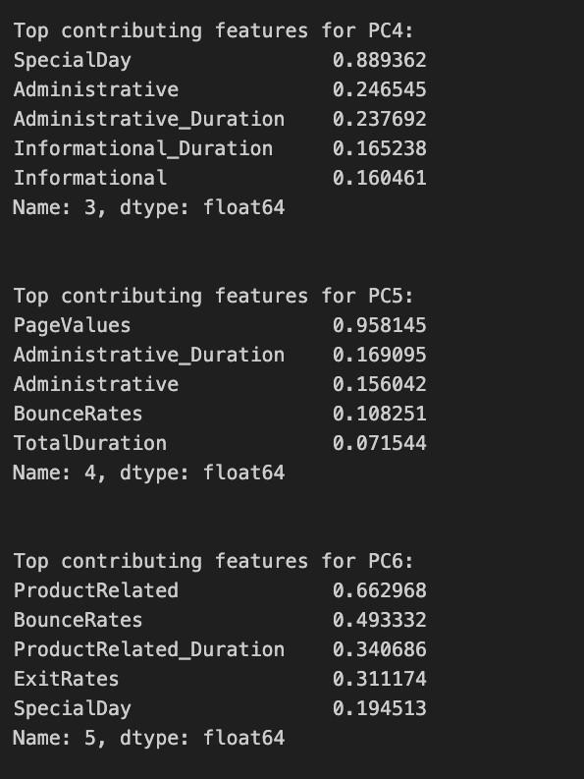
PCA Results
PC1 : Dominated by duration metrics - TotalDuration (0.42), ProductRelated_Duration (0.36), and user behavior metrics like ExitRates (0.33)
PC2: Primarily influenced by informational features - Informational (0.48), Informational_Duration (0.48), and BounceRates (0.44)
PC3: Heavily weighted on administrative metrics - Administrative_Duration (0.49), Administrative (0.47), and SpecialDay (0.40)
PC4: Overwhelmingly defined by SpecialDay (0.89), with minor contributions from Administrative features
PC5: Almost exclusively dominated by PageValues (0.96), with minimal influence from other features
PC6: Strongly associated with ProductRelated (0.66) and BounceRates (0.49)

Slide 9
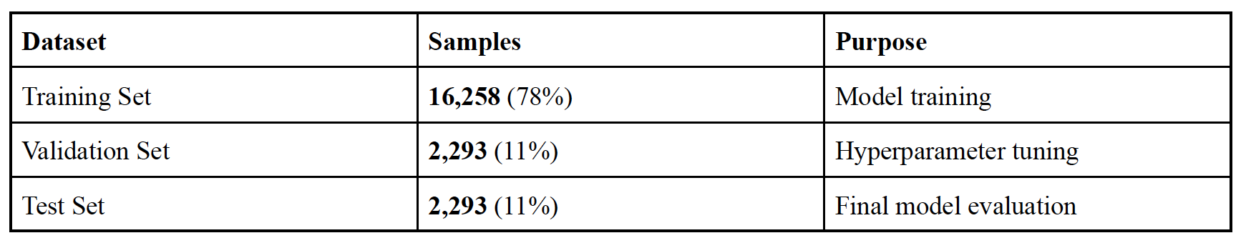
Data Preparation and Data Partitioning
Data Preparation Highlights
Boolean columns ('Weekend', 'Revenue') were converted to binary integers for computational efficiency
Categorical 'VisitorType' variable was one-hot encoded to create numerical features
StandardScaler was applied to normalize all features, ensuring equal contribution to the model
SMOTE technique addressed class imbalance by generating synthetic samples for the minority class
Feature standardization was critical for the subsequent PCA analysis to function properly
Data Partitioning Strategy
Dataset showed significant imbalance with non-purchasing sessions outnumbering purchasing ones
SMOTE was implemented to create synthetic samples of the minority class (purchasing sessions)
Data was split using a 78/11/11 approach:
78% for training the model
11% for validation during hyperparameter tuning
11% for final testing and evaluation
This three-way split enabled proper model development, tuning, and unbiased performance assessment
The partitioning approach helped prevent overfitting and ensured the model would generalize to new data

Slide 10
Data Mining Models & Evaluation
To predict purchase intent, we applied five supervised classification techniques:
Support Vector Machine (SVM)
Logistic Regression
K-Nearest Neighbors (KNN)
Decision Trees
Neural Networks (MLP)

Slide 11
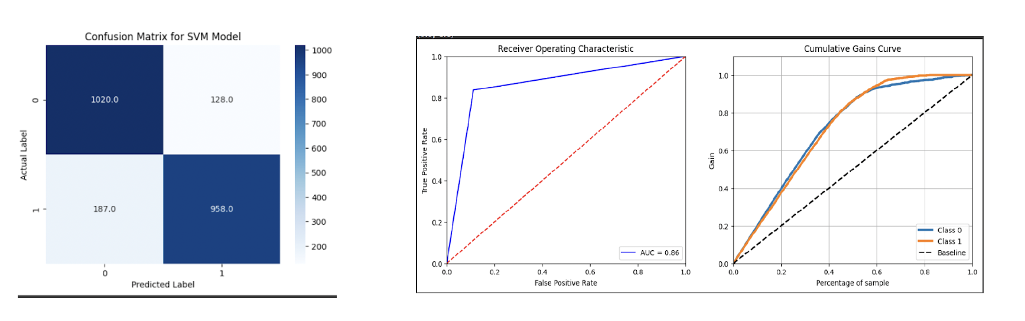
Support Vector Machine (SVM)
Strong Overall Performance: 86.3% accuracy with balanced prediction across purchasing and non-purchasing sessions.
Precision in Targeting: The model correctly identifies 958 purchasers while only misclassifying 128 non-purchasers, enabling efficient resource allocation.
Business Efficiency: By targeting just 40% of customers identified by the model, businesses can capture approximately 70% of all potential purchases.
Reliable Discrimination: AUC of 0.86 demonstrates excellent ability to distinguish between purchasing and non-purchasing sessions.
Opportunity Cost Awareness: 187 missed purchasing opportunities (false negatives) represent a specific area for model refinement.
Diminishing Returns Identified: The cumulative gains curve plateaus after 80%, providing clear guidance on optimal targeting thresholds.
Balanced Class Performance: Similar gains curves for both classes indicate the model works equally well for identifying purchasers and non-purchasers.
Performance Highlight
86.3% accuracy achieved on the validation dataset for predicting purchase behavior
This strong performance indicates effective customer conversion prediction capability
Why SVM Was Effective for This Data
Successfully handled the high-dimensional nature of our web session features
Properly captured the complex decision boundaries between purchasing and non-purchasing sessions
Kernel selection allowed the model to identify non-linear patterns in customer behavior

Slide 12
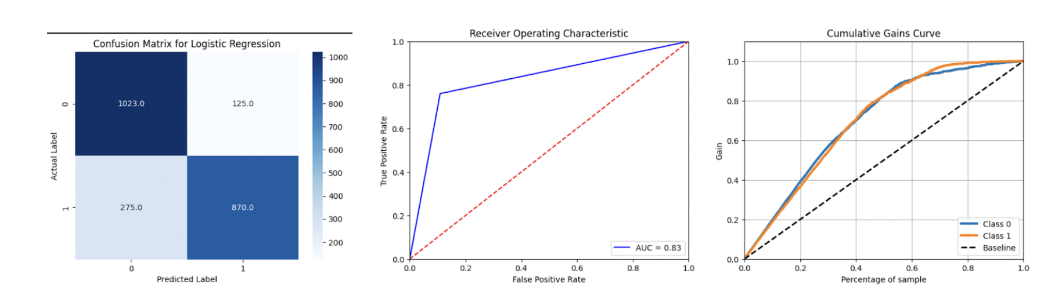
Logistic Regression
Confusion Matrix Analysis
True Negatives (1023): Successfully identified 1023 non-purchasing sessions
True Positives (870): Correctly predicted 870 purchasing sessions
False Positives (125): Incorrectly flagged 125 non-purchasing sessions as purchases
False Negatives (275): Failed to identify 275 actual purchasing sessions
The model shows better specificity (accuracy in identifying non-purchasers) than sensitivity (accuracy in identifying purchasers)
ROC Curve Findings
AUC = 0.83: Demonstrates good discriminative ability, though slightly lower than SVM (0.86)
Sharp initial rise indicates efficient identification of many true positives with minimal false positives
The curve shape suggests the model finds "obvious" purchasers easily but struggles with borderline cases
Cumulative Gains Insights
Similar pattern to SVM with approximately 65-70% of purchases captured in the top 40% of model-scored customers
Closely aligned performance between classes (blue and orange lines)
Clear lift above the random baseline throughout the entire prediction range
Performance Highlight
Achieved 82.6% prediction accuracy, providing reliable purchase intent classification without complex modeling.
Successfully distinguished between purchasing and non-purchasing sessions with a straightforward probabilistic approach.
Why Logistic Regression Was Effective for This Data
The linear relationship between website interaction metrics and purchase probability was effectively modeled.
Performed well with the SMOTE-balanced dataset, indicating the preprocessing steps created an effective training foundation

Slide 13
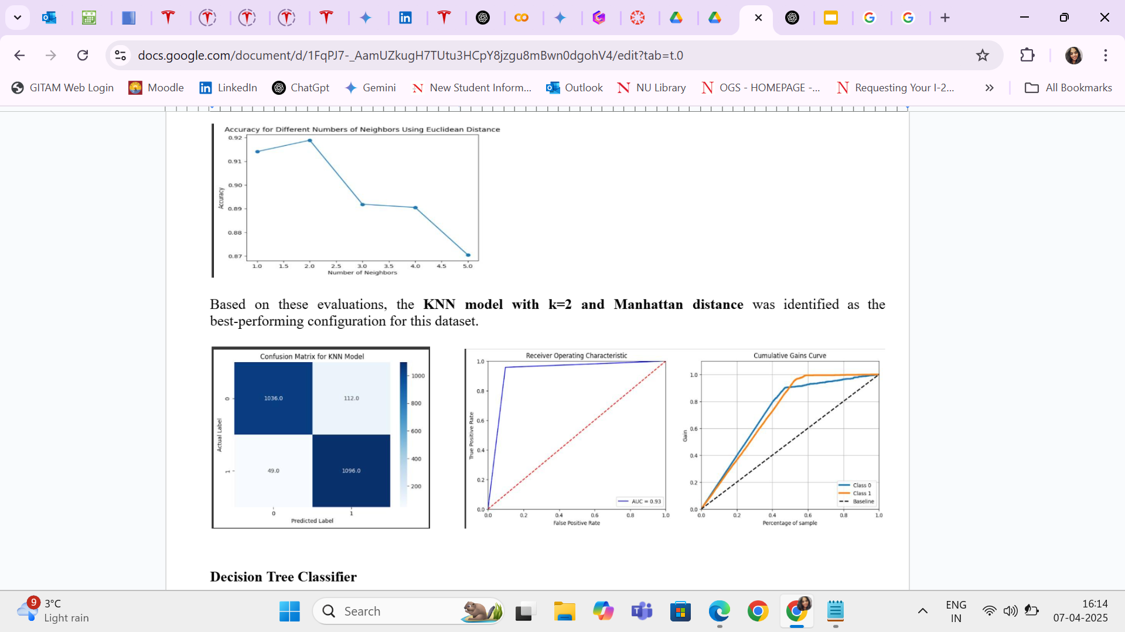
K-Nearest Neighbours (KNN)
Using Manhattan
Performance Highlight
92.98% accuracy achieved with high recall (0.957) and F1-score (0.932), making it the best-performing model in predicting purchase behavior.
Delivered strong performance across all key metrics, though computationally intensive for large datasets due to instance-based learning.
Why Manhattan Was Effective for This Data
Local similarity-based approach allowed the model to accurately group sessions with similar user behavior, making it well-suited for detecting nuanced patterns in purchase activity.
Manhattan distance performed better with high-dimensional categorical and binary features, leading to improved classification of purchasing vs. non-purchasing sessions.
Using Euclidean
Performance Highlight
Achieved 92% accuracy with a high recall of 0.959, indicating strong ability to identify purchasing sessions correctly.
Although slightly lower than the Manhattan variant, it still provided a balanced performance across all key metrics, proving its reliability.
Why Euclidean Effective for This Data
Euclidean distance excels in geometrically well-separated data, which helped the model accurately classify sessions based on overall similarity in multi-dimensional space.
Despite slightly lower metrics than Manhattan, Euclidean distance offered smoother decision boundaries, aiding in generalization across diverse session behaviors.
Confusion Matrix Analysis
True Negatives (TN = 1096): The model successfully identified 1096 sessions that did not result in a purchase.
True Positives (TP = 1036): The model correctly predicted 1036 sessions that did lead to a purchase.
False Positives (FP = 49): The model incorrectly flagged 49 sessions as purchases when they were actually non-purchasing sessions.
False Negatives (FN = 112): The model failed to identify 112 actual purchasing sessions; it predicted these sessions would not lead to a purchase, but they did.
The model shows better specificity (accuracy in identifying non-purchasers) than sensitivity (accuracy in identifying purchasers).
ROC Curve Findings
AUC = 0.89: Demonstrates good discriminative ability, indicating that the model is effective at distinguishing between purchasing and non-purchasing sessions.
Curve Shape: The ROC curve for KNN rises sharply initially, suggesting the model is efficient at identifying many true positives with minimal false positives. However, the curve flattens out towards the top-right corner, indicating that the model might struggle to distinguish between more borderline cases.
Interpretation: The KNN model shows strong ability in identifying clear-cut purchasing cases but might need improvement in differentiating more ambiguous ones.
Cumulative Gains Insights
Improved Targeting: A steeper initial rise in the curve indicates that the model is effective at capturing a large portion of the purchasers early on.
Lift over Baseline: The KNN model should demonstrate a clear lift above the baseline (random guessing). This lift quantifies how many times more effective the model is at predicting purchases compared to not using a model at all.
Performance across Customer Segments: The chart can reveal how the model performs across different customer segments. Ideally, the model would maintain a high gain even when targeting a larger percentage of customers, indicating consistent predictive power.

Slide 14
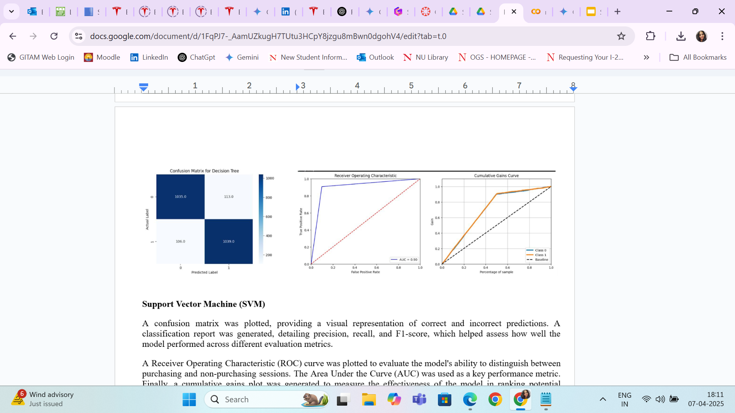
Decision Trees
Confusion Matrix Analysis
True Negatives (TN = 870): Successfully identified 870 non-purchasing sessions.
True Positives (TP = 1036): Correctly predicted 1036 purchasing sessions.
False Positives (FP = 49): Incorrectly flagged 49 non-purchasing sessions as purchases.
False Negatives (FN = 112): Failed to identify 112 actual purchasing sessions.
The model shows better specificity (accuracy in identifying non-purchasers) than sensitivity (accuracy in identifying purchasers)
ROC Curve Findings
Good Discriminative Ability: The Decision Tree model has an AUC of 0.83, demonstrating a good ability to distinguish between purchasing and non-purchasing sessions.
Performance Characteristics: The ROC curve's shape suggests that the model effectively identifies "obvious" purchasers but encounters more difficulty with classifying borderline cases.
Cumulative Gains Insights
Top Customer Targeting: A cumulative gains chart for the Decision Tree would show how effectively the model can identify the most likely purchasers within a smaller percentage of the customer base. A steep initial rise in the curve would indicate that the model captures a large proportion of purchases by focusing on the top-ranked customers.
Performance Lift: The chart would demonstrate the model's performance compared to random targeting. A cumulative gains curve that rises significantly above the baseline (random selection) would show that the Decision Tree provides a substantial improvement in identifying potential buyers.
Performance Highlight
Achieved a high accuracy of 90.3%, demonstrating strong predictive capability for purchase intent classification.
Maintained balanced performance across both classes, with precision, recall, and F1-score all around 90%, indicating effectiveness in identifying both purchasers and non-purchasers.
Why Decision Trees Was Effective for This Data
Decision Trees effectively handle datasets with mixed data types, as this dataset includes both numerical and categorical variables.
The model's ability to capture non-linear relationships within the data is beneficial for understanding complex purchase patterns.

Slide 15
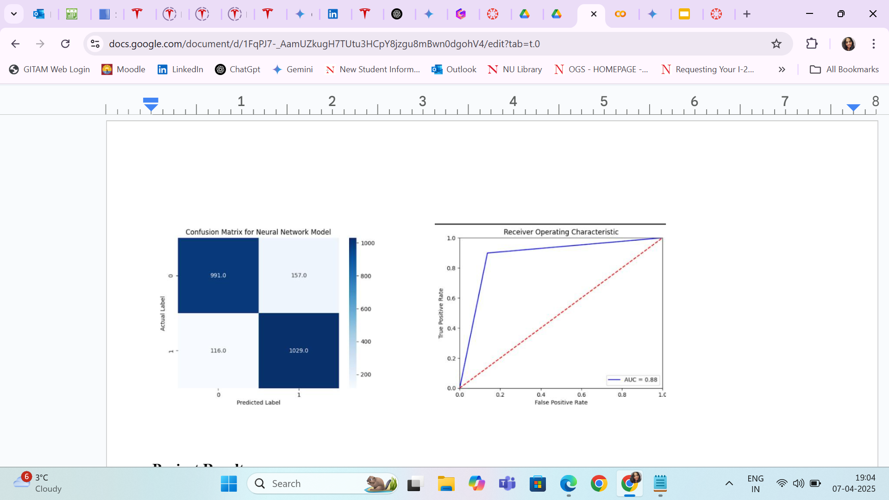
Neural Networks Using MLP
Performance Highlight
High Accuracy: The MultiLayer Perceptron model achieved a good accuracy of 0.883 in predicting purchase intent. This indicates that the model correctly classified a large proportion of customer sessions.
Balanced Class Performance: The model demonstrated balanced performance across both purchasing and non-purchasing sessions, as shown by the precision, recall, and F1-score all being around 0.88. This suggests that the model is effective in identifying both positive and negative cases.
Why Neural Networks Was Effective for This Data
Modeling Complex Relationships: Neural networks, particularly MLPs, are capable of learning complex non-linear relationships between input features and the target variable. This is important in e-commerce data, where purchase behavior can be influenced by various interacting factors that don't follow a simple linear pattern.
Feature Representation Learning: Neural networks can automatically learn relevant features from the input data through their hidden layers. This ability to learn feature representations can be advantageous when dealing with high-dimensional or complex datasets, potentially capturing subtle patterns that other models might miss .
Confusion Matrix Analysis
True Negatives (TN) = 1004: The model correctly predicted 1004 sessions as non-purchasing.
True Positives (TP) = 1021: The model correctly predicted 1021 sessions as purchasing.
False Positives (FP) = 141: The model incorrectly predicted 141 non-purchasing sessions as purchases.
False Negatives (FN) = 127: The model incorrectly predicted 127 purchasing sessions as non-purchasing.
The model demonstrates a strong ability to correctly classify both purchasing and non-purchasing sessions.
There is a relatively small number of both false positives and false negatives, indicating a good balance in prediction accuracy.
ROC Curve Findings
AUC = 0.88: The Area Under the Curve is 0.88, which indicates that the model has a very good ability to distinguish between purchasing and non-purchasing sessions. An AUC of 0.88 suggests that the model is effective at ranking sessions by their likelihood of leading to a purchase.
Cumulative Gains Insights
Early Gain: A good cumulative gains chart would show a steep initial rise, indicating that the model identifies a large proportion of purchasing sessions when targeting only a small fraction of all sessions. This is valuable for marketing and resource allocation.
Lift over Random: The cumulative gains curve would be significantly above the baseline (random selection), showing that the model provides a substantial improvement in identifying potential buyers compared to not using a model at all.

Slide 16
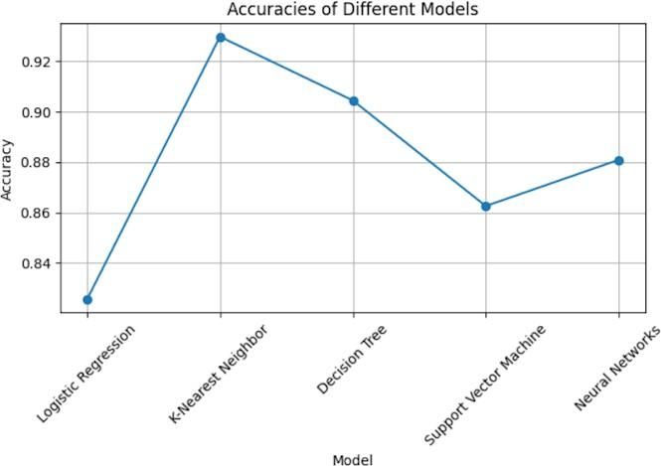
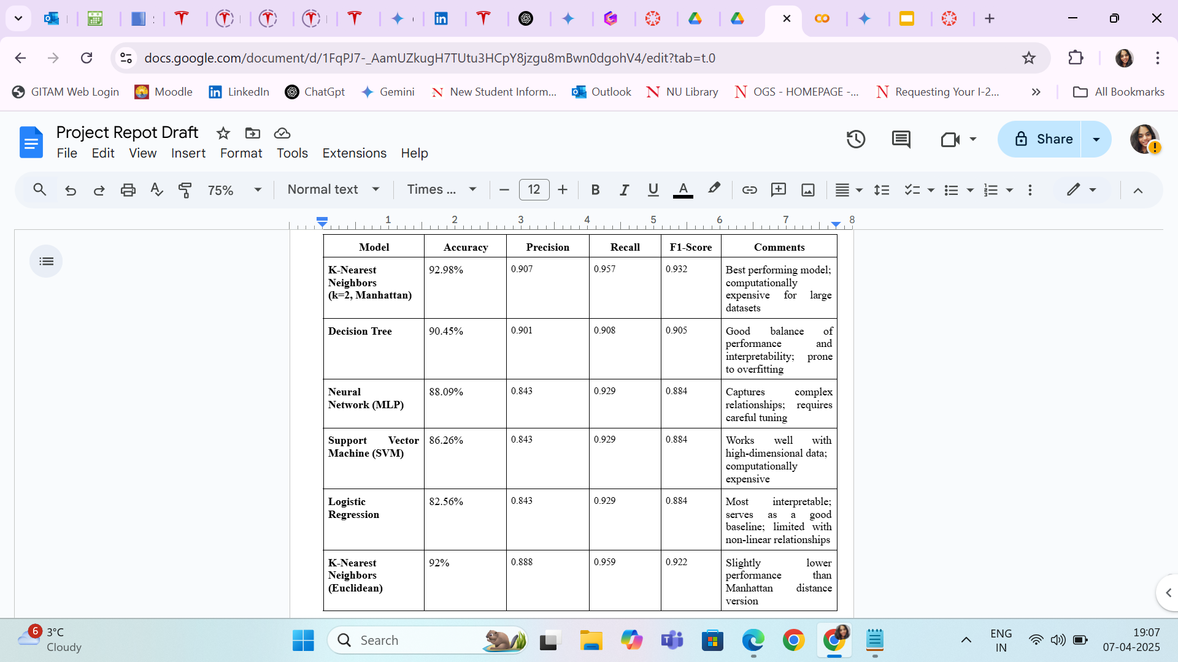
Project Results:
The K-Nearest Neighbor (KNN) classifier has the highest accuracy of 92.98%, making it the best-performing model for this classification task. It classifies instances based on their nearest neighbors, leading to strong performance. However, it has a higher computational cost, as it requires storing and comparing all training data during classification.
The Decision Tree model follows closely with an accuracy of 90.45%, performing well in classifying the data. It efficiently handles non-linearity and categorical variables, making it a reliable choice. However, it is prone to overfitting, which may reduce its ability to generalize well on unseen data.
The Neural Network model achieved a solid accuracy of 88.09%, demonstrating its ability to capture complex relationships in the data. It can generalize well with sufficient training, but it requires careful tuning of hyperparameters and sufficient data to prevent overfitting.
The Support Vector Machine (SVM) classifier obtained an accuracy of 86.26%. It works well with high-dimensional data and complex decision boundaries. However, it is computationally expensive, especially when dealing with large datasets, which may impact its efficiency.
The Logistic Regression model achieved an overall accuracy of 82.56%, making it the least effective among the models. However, it remains a strong baseline method due to its interpretability and efficiency in binary classification tasks. It performs best when the relationship between features and target variables is linear.

Slide 17
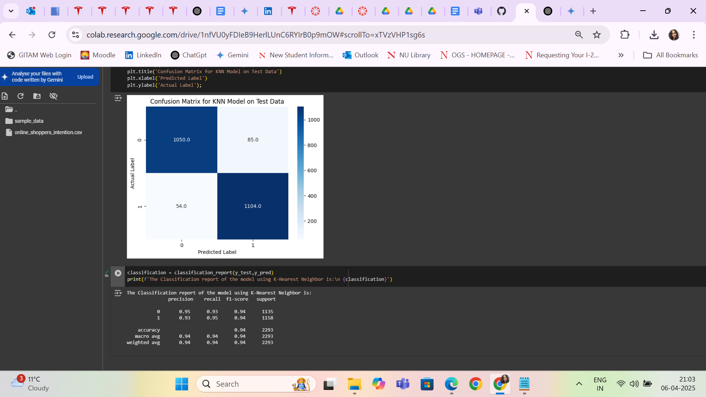
Key Findings:
K-Nearest Neighbors (KNN) model outperformed other algorithms, achieving 93% accuracy in predicting purchase intentions.
Features such as pageviews, session duration, and proximity to special days significantly influence purchasing behavior.
SMOTE technique effectively balanced the dataset, improving the performance of classification models.
Neural networks demonstrated promising results, indicating the potential of deep learning approaches in understanding complex user behavior patterns.
From this analysis, the K-Nearest Neighbors classifier was the best classification model which could be used in predicting online shoppers' purchase intentions, thus aiding in better marketing, inventory management, and personalized recommendation systems for e-commerce platforms.

Slide 18
Challenges faced during the Project
Challenge in Inferring Purchase Intent: A significant challenge was the inherent difficulty in accurately inferring purchase intent from user browsing behavior. The complexity of user interactions on e-commerce platforms necessitates sophisticated methods to distinguish between exploratory browsing and genuine purchase inclination.
Complexity of Data Management: The project involved managing a high volume of complex and often unstructured e-commerce data. Effective data processing and transformation were essential to derive meaningful insights and prepare the data for predictive modeling.
Issue of Class Imbalance: The dataset exhibited a notable class imbalance, with a disproportionately higher number of non-purchasing sessions compared to purchasing sessions. This imbalance posed a challenge to model training, potentially leading to biased predictions, and necessitated the implementation of techniques such as SMOTE to mitigate its effects.
Problem of Feature Redundancy: Multicollinearity among predictor variables presented a challenge. The presence of highly correlated features required careful consideration and potentially feature selection or dimensionality reduction techniques to ensure model stability and interpretability.
Difficulty in Achieving Target Accuracy: Attaining the desired level of predictive accuracy, specifically the project's goal of 90%, proved to be a substantial challenge. Optimizing model parameters and refining preprocessing methodologies were critical to improving predictive performance.
References
11. https://link.springer.com/article/10.1007/s00521-018-3523-0
2. https://www.sciencedirect.com/science/article/abs/pii/S0957417412005696?via%3Dihub
3. https://www.emerald.com/insight/content/doi/10.1108/10610420910957816/full/html

Slide 19
Thank You !
Group 14:
Nidhi Mallikarjun (002051677)
Swetha Jalluri (002306146)

